Slide 1

Karl – About Me
I like being in the outdoors. I enjoy hunting and fishing and going for bike rides. For my work experience I did several yardwork projects for my family. I am a hard worker and I enjoy helping others.

Slide 2
Fact
Fantasy Fiction
I swam with a dolphin | I have been to Germany | I caught an alligator

Slide 3
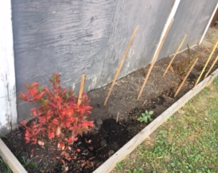
Practicum #1
My tasks were to:
Take down the pool, cut down branches on some trees and pick-up fruit of the ground.
I learnt, about the tasks and about myself the following things:
I learned to keep the yard clean and tidy
I learned that I like working outside and hard work

Slide 4
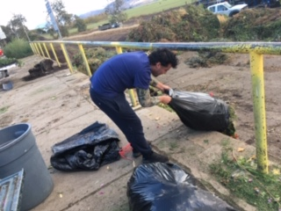
Practicum #2
My tasks were to:
To mow the lawn, to weed whack, and pull flowers from the beds.
I learnt, about the tasks and about myself the following things:
I learned to keep the yard clean and tidy
I learned that I like working outside and hard work

Slide 5
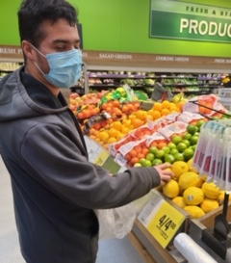
Practicum #3
My tasks were to:
Learn to ride the bus, plan a menu, find things in the store and buy groceries.
The things I learnt:
I learned it was important to get from point A to point B by myself.
It was fun to plan a menu. It was fun having a grocery list and looking for things in the store. I love shopping.

Slide 6
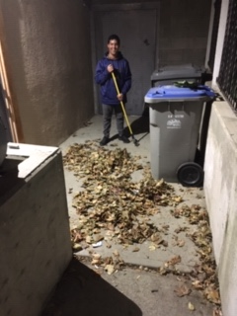
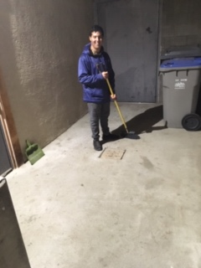
Practicum #4
My tasks were to:
Do some cooking, landscaping, make some spaghetti and meatballs, and go grocery shopping.
I learnt, about the tasks and about myself the following things:
That when I am cooking, I need to prepare and to leave lots of time.
I learned how to weigh food in kg and lbs.
I really enjoyed doing the cleanup of the leaves and the yard.

Slide 7
Evaluation of my Fall practicums:
The practicums I liked the most were number 1 and 2 because I got to work hard.
The practicum I liked the least was number 4 because there was no more landscaping to do.
Overall, I am learning to work hard and to be a good employee.
These are the things I am learning about myself:
I like landscaping and working outside
I would like to take the bus more often
I love cooking

